Slide 1
Budgeting
Caitlin Synovec, OTD, OTR/L, BCMH

Slide 2
Budgeting
Why make a budget?
It ensures you have enough money for the things you need.
It ensures you have enough money for the things that are important to you.
It helps prevent problems in the future.
It can help you prepare for emergencies or unexpected expenses.
What is a budget?
A budget is an individualized plan of how you use your money.
It helps you organize how much money you have to spend and what you need to spend it on.
It also looks at how much money you plan to spend on each item, and then how much money you actually spent on each item.
This helps you evaluate your budget on a regular basis.

Slide 3
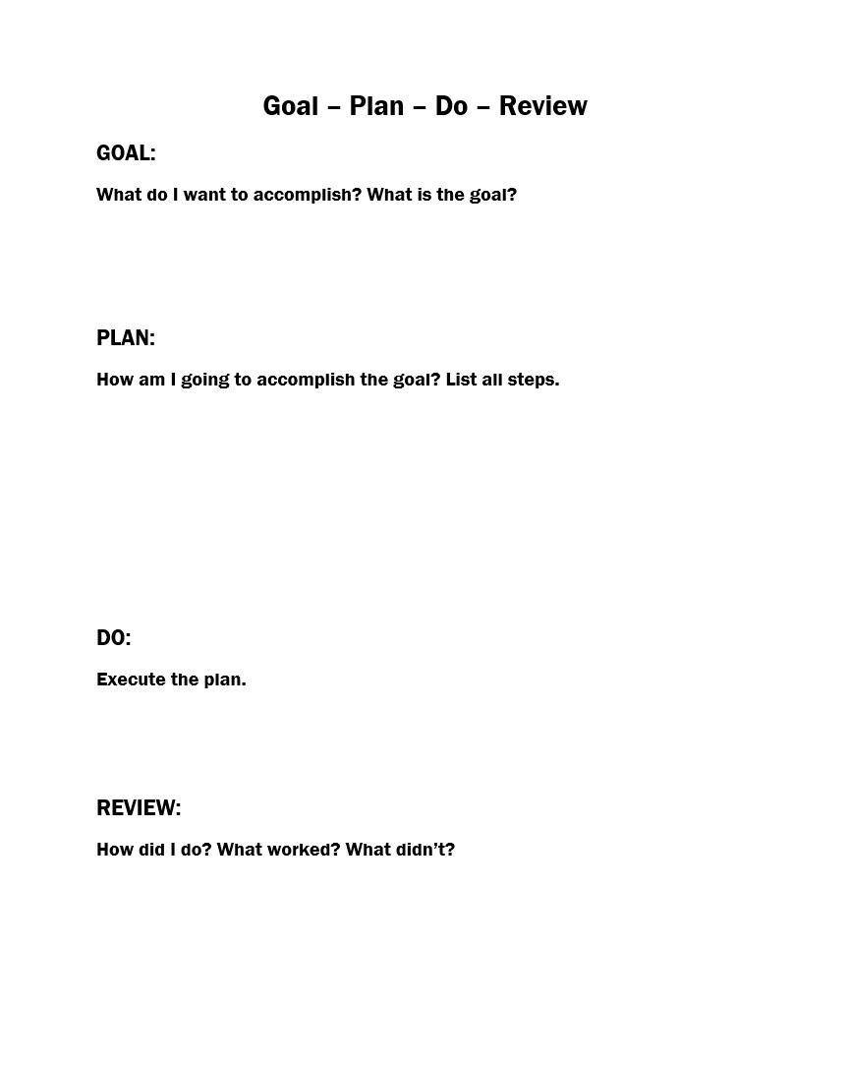
Goal –Plan – Do – Review

Slide 4
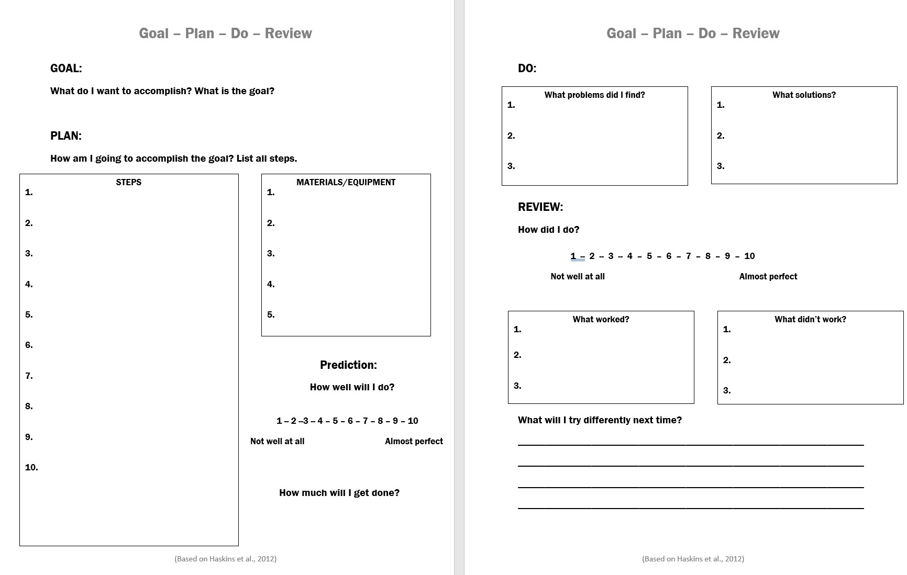

Slide 5
Goal
What do I want to accomplish?
What is the goal?
Planning out my monthly budget
Identify my expenses
Make sure I save some money each month

Slide 6
Plan
1. Identify your monthly income
2. Write down a list of all of your expenses
3. Put your list of expenses into a budget sheet
4. Write down the cost of the Fixed expenses
5. Find out how much money you have left
6. Estimate your Variable expenses
7. Add your Fixed and Variable Expenses together
Follow your budget!
Make sure your Variable expenses aren’t more than how much you have
Make sure the amount you have planned to spend isn’t higher than your income
How am I going to accomplish this goal?
Write down the steps.

Slide 7
Plan
Write down what you need to make a budget.
Pen or pencil
Paper
Budget sheet
Calculator
Copies of my bills

Slide 8
Prediction
How well will I do?
1 – 2 – 3 – 4 – 5 – 6 – 7 – 8 – 9 – 10
Not well at all Almost perfect
How much will I get done?

Slide 9
Do – Make a Budget

Slide 10
1. Identify your monthly income.
Include everywhere you might get money from regularly.
Social Security Income (SSI)
Social Security Disability Income (SSDI)
Work
Worker’s Compensation

Slide 11
1. Identify your monthly income.
Write the total amount you earn each month next to “Total Monthly Income”
Total Monthly Income
Total Monthly Expenses
Amount Remaining
$750

Slide 12
2. Write down a list of all of your expenses.
Fixed Expenses
Variable Expenses
Rent
Gas and electric
Cable
Internet
Phone
Debt
Medications
Food/Groceries
Eating out or Fast food
Transportation
Hygiene/toiletries
Household
Laundry
Leisure/fun
Clothes/shoes
Savings
Medical
Tobacco
Gifts
Miscellaneous

Slide 13
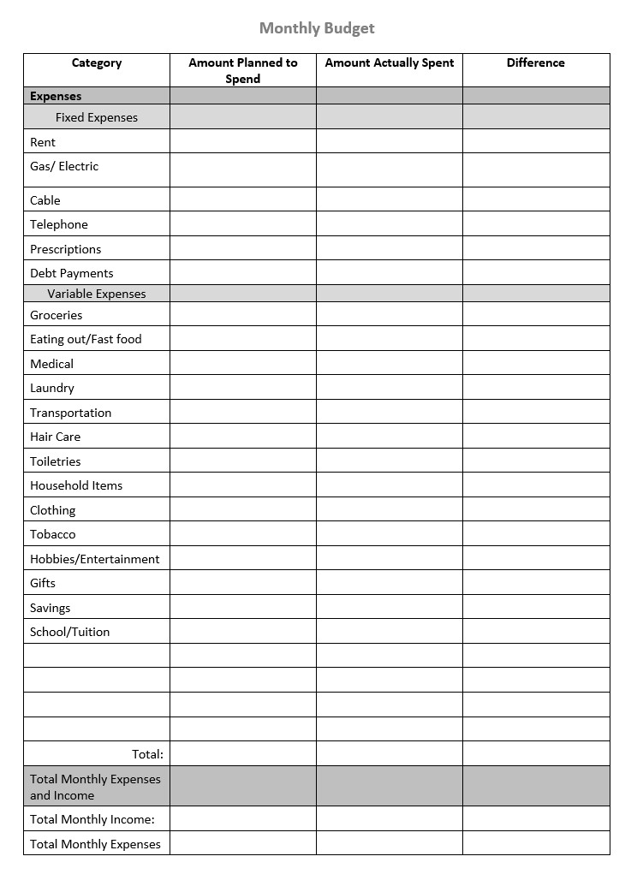
3. Put your list of expenses into a budget sheet
$750

Slide 14
4. Write down the cost of the Fixed expenses
Fixed Expenses | Amount Planned to Spend
Rent
Gas/ Electric
Cable
Telephone
Prescriptions
Total
$250
$85
$89
$55
$15
$494

Slide 15
5. Find out how much money you have left
Add the total of your fixed expenses.
Subtract that amount from your total income.
Total Income: $750
Fixed Expenses: $494
750
– 494
256
$256 for Variable Expenses

Slide 16
6. Estimate Your Variable Expenses
Write down how much you think you will need for the month for each item.
Start with the most important.
Make sure that the total of your Variable expenses is not more than the money you have left.
$256 for Variable Expenses

Slide 17
6. Estimate Your Variable Expenses
Variable Expenses | Amount Planned to Spend
Groceries
Eating Out
Transportation
Laundry
Toiletries
Household
Leisure
Savings
Miscellaneous
Total
$100
$20
$22
Tips:
Add the amounts as you go along
Start with the most important things first
Look at last month’s budget or receipts to estimate
Over-estimate
$20
$15
$15
$25
$10
$20
$247

Slide 18
7. Add your Fixed and Variable Expenses together
494
+ 247
741
Fixed Expenses: $494
Variable Expenses: $247
Total Monthly Income | $750
Total Monthly Expenses
Amount Remaining
$741
$9
Make sure this amount is not higher than your income.

Slide 19
Fixed Expenses | Amount Planned to Spend
Rent | $250
Gas/ Electric | $85
Cable | $89
Telephone | $55
Prescriptions | $15
Total | $494
Fixed Expenses | Amount Planned to Spend
Groceries | $100
Eating Out | $20
Transportation | $22
Laundry | $20
Toiletries | $15
Household | $15
Leisure | $25
Savings | $10
Miscellaneous | $20
Total | $247
Total Monthly Income | $750
Total Monthly Expenses | $741
Amount Remaining | $9

Slide 20
Do – Problems and Solutions
What problems did I find?
I don’t know how much I spend on variable expenses every month
What solutions?
I looked at old receipts or my bank statement from last month

Slide 21
Review
How did I do?
1 – 2 – 3 – 4 – 5 – 6 – 7 – 8 – 9 – 10
Not well at all Almost perfect
What worked?
What didn’t work?
What will I try differently next time?

Slide 22
Following Your Budget

Slide 23
Goal Plan Do Review
Follow my budget

Slide 24
Make a Plan to Follow Your Budget
Pay for the most important things first
Pay bills on the first day of the month or when you receive your money
It’s always OK to pay your bills before they are due!

Slide 25
Make a Plan to Follow Your Budget
Identify how much money you have to spend each week
Set a weekly spending amount
Set a plan for when you will go shopping or buy certain items

Slide 26
Make a Plan to Follow your Budget
Track your spending
Check in at the end of each week to compare your spending to your estimated plan

Slide 27
Make a Plan to Follow your Budget
Take out money in an envelope for each part of your budget and use that envelope to pay for those expenses
Use only cash to pay for items at the store from your envelope
Only go to the ATM once a month or once a week

Slide 28
Make a Plan to Follow your Budget
Use a support person
Pick someone to check in with
Take someone to the store or to go shopping with to help stick to your plan

Slide 29
Goal Plan Do Review
Follow my budget

Slide 30
Do - Following a Budget
Write down how much you spent on each of your budget items
Subtract that amount from how much you planned to spend
Identify anywhere you spent less or more money than planned
Check your budget before spending money
Use your strategies to stick to your plan

Slide 31
Fixed Expenses | Amount Planned to Spend | Amount Actually Spent | Difference
Rent | $250 | $250 | 0
Gas/ Electric | $85 | $85 | 0
Cable | $89 | $89 | 0
Telephone | $55 | $55 | 0
Prescriptions | $15 | $15 | 0
Total | $494 | $494 | 0
Fixed Expenses | Amount Planned to Spend | Amount Actually Spent | Difference
Groceries | $100 | $150 | -$50
Eating Out | $20 | $10 | $10
Transportation | $22 | $22 | $0
Laundry | $20 | $12 | $8
Toiletries | $15 | $10 | $5
Household | $15 | $18 | -$3
Leisure | $25 | $37 | -$12
Savings | $10 | 0 | $10
Miscellaneous | $20 | 0 | $20
Total | $247 | $259 | -$12
Total Monthly Income | $750 | $750
Total Monthly Expenses | $741 | $753 | -$12
Amount Remaining | $9 | -$3

Slide 32
Consequences of Overspending
Overdrafting account or paying fees
Starting the next month with a negative balance
Not having money for things you want or need

Slide 33
Goal Plan Do Review
Follow my budget
Use last month’s budget to help plan for the next month!

Slide 34
Final thoughts…
Budgeting takes practice
Budgets might change from month to month as your life changes
Use your budget to help meet your long-term goals

