Slide 1
Brain Injury Provider Activities: Tips & Tools
Anastasia Edmonston, TBI Partner Grant Coordinator
2020

Slide 2
“What lies behind you and what lies in front of you pales in comparison to what lies inside of you” Ralph Waldo Emerson
Thank you for all you do.

Slide 3
Activities are Therapeutic!
Engage and Focus the Mind
Promote new learning
Help with attention and concentration
Build Relationships and Social Skills by:
Challenging listening and communication
Requiring team work
Promote feelings of Self Worth by:
Encouraging self control
Allowing others to get to know something new about you

Slide 4
Stages of Recovery from Brain Injury (Adapted from Ben-Yishay 1978)
Engagement: not a one time thing, we engage, disengage and reengage with people, situations, throughout our lives, engagement is important to and for all of us! You can’t begin anything new, a job a relationship, a change in your life (like a pandemic) unless you engage with it
Awareness: Knowing our strengths and weaknesses, how we impact others with our words and actions, learning how to support/compensate for the areas in which we are not strong
Mastery: Trying something new, or trying something you used to do well and either finding you can do it again, or you can find another way of mastering the same thing. If your eyesight is impaired due to age, or because of a brain injury, other ways to “read” books. For example, large type, books on CD or an app like Audible where you can listen to books
Notes:
Stress this is something we all can relate to, not just people living with brain injuries.
Awareness: I have NO sense of direction and terrible visual spatial skills. So for navigating my way in a new place, maps are not my friend. Thank goodness for step by step directions provided by mapquest or google maps. It took me years to stop feeling bad for this issue! My husband, a physicist, loves maps and would get so angry when we were driving and I was a crummy navigator. Now we have the tools so that folks like me don’t feel so frustrated, or get so lost!

Slide 5
Stages Recovery from Brain Injury (Adapted from Ben-Yishay 1978)
Adjustment/Acceptance: Some people will accept disruptions, the bad things that happen to them, for many of us, that is asking too much! It is okay not to accept, but adjust, one day at a time
Competence: Getting good at something, anything qualifies, from learning how to drive to learning how to keep your thoughts (and sometimes hands) to yourself and once you are competent, you get even better by practicing, often finding that competence in one area leads to competence in another
Identity: In the case of small and large challenges, people may experience what is called “post traumatic growth” or resilience. For people who have a brain injury and found their identities rooted in their work, “I am a teacher”, “I am a mechanic”, I am a student” etc. this can be very, very difficult but not impossible
Notes:
Maybe they accept more easily because they have the benefit of life experiences and its up and downs. Maybe they have a strong faith in something greater than themselves that helps them weather challenges.

Slide 6
Groups are a Process, not a Product
They need to be:
Interesting
Relevant
Age Appropriate
Interactive
AND….. What ever the activity is, permission from the participants should be given and/or choices provided. Those who are not interested in actively participating should be encouraged to observe and periodically asked to join or express an opinion

Slide 7
Tips for Engagement
Provide a “graphic organizer” this is simply something that can anchor and focus attention on the task at hand. It can be a handout or poster paper with the main points of the activity
Co-present with another staff person
Have a participant lead the activity
Bring in a virtual guest speaker!

Slide 8
Tips for Engagement
Role Play-job interview prep, conversations with provider about concerns/self advocacy
Interviews (prepare a script, have participants interview each other or a staff)
Possible questions:
“How long have you worked in this field?”
“ Can you tell me about your hobbies, family, pets” etc
“Tell us about the best vacation you ever took and why”
“What is the thing you are most looking forward to after this pandemic is over?”
Information learned from interviews can be published (with permission) in a newsletter….

Slide 9
Tips for Engagement
Produce a newsletter (digital and hardcopy), create job descriptions for:
reporters
writers
typists/designers
research and include links to topics of interests/resources

Slide 10
General Guidelines and Suggestions
Hold regular house meetings and brain storm things to do together and apart, create a weekly schedule based on consensus. Create, keep and share a daily and weekly schedule, post in multiple places ( participant’s rooms, common areas, on the kitchen fridge)
Allow for individual choice, allow for 1:1 with staff if possible based on provider’s choices

Slide 11
Examples for Incorporating Suggestions from the Activity Tip Sheet
Keeping in Mind that any purposeful, collaborative effort between two or more people has benefits for anyone!

Slide 12
To Recap-the Benefits of Collaboration
Promotes Teamwork
Strengthens verbal and nonverbal communication skills, this includes the ability to listen, really listen to others
Improves frustration tolerance
Improves the ability to follow directions
Improves the ability to seek and receive feedback and to be able to incorporate it into ones efforts in real time
Improves the ability to monitor one’s own abilities and growth as it’s happening

Slide 13
Examples of How to Utilize the Provider Activity Tips
Breaking Bread Together
Come to agreement on the menu for a special dinner, suggested themes include:
Favorite childhood dishes
Dishes from different countries and cultures
Chili contest
Staff share a favorite dish from their family
Participants prepare and treat the staff to a meal
Family and Friends participate via Zoom/FaceTime

Slide 14
Examples of How to Utilize the Provider Activity Tips
Exercise: Staff can provide an overview of resources on line as well as what is available in the community such as parks. As part of the overview, they can show clips of on-line resources such as the ones below. Staff can engage with participants in a discussion about the benefits of exercise
Love Your Brain Foundation-Free meditation and yoga session
How To: Exercise in a Wheelchair-videos for seated exercise
Walk at Home, Leslie Sansone’s videos offer easy walking routines https://www.youtube.com/channel/UCVl6ZdslZz2Zj-34bMJFPbg
Yoga with Adriene, free yoga videos for all levels https://yogawithadriene.com/

Slide 15
Suggestions for Structuring Group Discussions around a specific topic, for example-Exercise and the Brain
Put a big piece of poster paper on the wall, and ask the group:
What do you know about the benefits of Exercise and the Brain?
jot down all responses
What do you want to know about the benefits of Exercise and the Brain?
jot down all responses
Depending on the answers you receive, you may have the makings of a half an hour discussion right off the bat! If not….

Slide 16
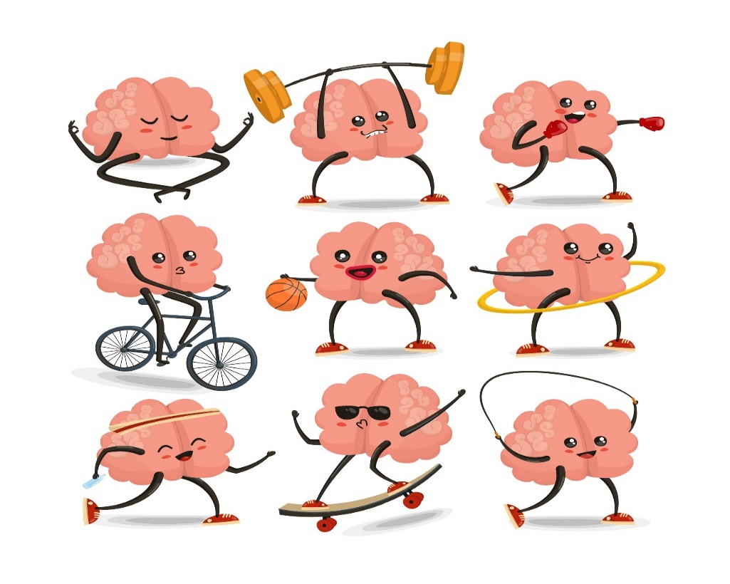
Suggestions for Structuring Group Discussions around a specific topic, for example-Exercise and the Brain
You don’t have to share all this information of course, but here is some interesting information about what exercise does for us, mind, body and soul!

Slide 17
Researchers have found that for people with brain injuries, exercise can:
Improve perceived quality of life
Result in in better mental functioning
Improve alertness
Decrease physical and mental fatigue
Improve stamina
May decrease depression and Improve sleep

Slide 18
Researchers have found that for people in general, exercise can:
Increase the size of our frontal and temporal lobes as well as our hippocampus! These parts of our brain are responsible for learning new information and memory
In addition, exercise can promote a host of benefits that positively impact our brain health such as:
Decrease insulin resistance, = lowers risk of Diabetes!
Reduces Inflammation with possible benefits for those with or at risk of arthritis, asthma, and artery disease
Promotes growth of cells in the brain!

Slide 19
This study goes to show it is never to late to benefit from exercise!
The Cardiovascular Health Study, begun in 1986, produced data on the evaluations of nearly 6,000 older men and women
The top quartile of active people proved to have substantially more gray matter in those parts of the brain related to memory and higher level thinking
Those whose physical activity increased over a five-year period showed notable increases in gray-matter volume in those same parts of their brains
Those who had more gray matter correlated with physical activity also had 50 percent less risk of experiencing memory decline or Alzheimer’s

Slide 20
You maybe thinking, isn’t this a bit much?
To that I say, the Brain Injury Waiver serves adults, in my experience of creating and facilitating groups with people living with moderate to severe brain injuries for 16 years, I learned very early not to dumb things down, you may need to explain in more detail, break down information into small, manageable chunks, if you find a topic boring, so will the participants. I ran a health group for a period of time and we had a series of great discussions on the following topics….

Slide 21
Health Group Topics
The effects of smoking on the body/our health
Basic Anatomy-focus on our skeleton
The Male and Female Brain-what is the same, what is different (this was a favorite)
Alcohol and the Brain
What are the different parts and functions of the brain ( this was an excellent way to talk about brain injury in a way that wasn’t personal or upsetting)
When I ran this group, my employer would not let us have access to the Internet, I had to research these topics the old fashioned way, at the library!
Notes:
Covid-19

Slide 22
Suggested Exercise
Getting to Know Me
Ask each person in the group to identify two achievements (pre-injury). The first is an achievement that they did not receive any public recognition for, but it was something they set out to accomplish:
Name the achievement
Describe the achievement
Explain why it makes you proud
Staff models the presentation of the first achievement
Source: Adapted from the Head Trauma Program at NYU: Two Achievements Group Exercise

Slide 23
Suggested Exercise
Getting to Know Me
The second is an achievement that they did receive public recognition for—from their family, friends, co-workers, or their community at large:
Name the achievement
Describe the achievement
Explain why it makes you proud
Staff models the presentation of the second achievement
Source: Adapted from the Head Trauma Program at NYU: Two Achievements Group Exercise

Slide 24
Suggested Exercise
Getting to Know Me
Exercise benefits:
Encourages the person to redefine themselves apart from their injury
Reminds the person that they are accomplished and nothing can take that away from them
Allows others to learn something new and unique about that person
Inspires staff to better customize interventions, services, and goals
Source: Adapted from the Head Trauma Program at NYU: Two Achievements Group Exercise

Slide 25
Suggested Exercise
Getting to Know Me
Try it out:
Take a full group to model the activity. This will reinforce the steps and also offer the group to learn something they might never know about a person (within reason)
Meet with people prior to sharing their achievements with the group and create posters with their achievements that they can speak from

Slide 26
Other Ideas for Engagement
Group breaks into teams for “hangman”, charades, jigsaw puzzles, board games 20 questions, and cards
Movie nights, movies are voted on and watched over the course of one or several viewings depending on the needs of the group
It might help, especially if it is a complicated plot, to have the names of the characters and the actor’s pictures up on the wall or on a handout
Stop the movie at intervals and have a short discussion to make sure all are following/summarizing the plot so far, taking bets (with pennies) on the endings
(good for mysteries and horror movies!)

Slide 27
Other Ideas for Engagement
Watch classic sporting events, such as World Series or Super Bowl games
Take virtual tours of places such as museums
Watch concerts
Play games with other homes

Slide 28
Questions? Ideas?

Slide 29
Thank you
Anastasia Edmonston, MS, CRC
Maryland TBI Partner Grant Coordinator
Behavioral Health Administration
anastasia.edmonston@maryland.gov
410-402-8478
A product of the Behavioral Health Administration 2020

Slide 30
Thank you
Anastasia Edmonston, MS, CRC
Maryland TBI Partner Grant Coordinator
Behavioral Health Administration
anastasia.edmonston@maryland.gov
410-402-8478
A product of the Behavioral Health Administration 2020

Slide 31
The Maryland Traumatic Brain Injury Partner Grant “This project was supported, in part by grant number 90TBSG0027-01-00, from the U.S. Administration for Community Living, Department of Health and Human Services, Washington, D.C. 20201. Grantees undertaking projects with government sponsorship are encouraged to express freely their findings and conclusions. Points of view or opinions do not, therefore, necessarily represent official ACL policy.”
This product is copy write free, please feel to use and distribute widely, citation of the source is appreciated, please contact anastasia.edmonston@maryland.gov and let us know how you are using the materials, so we may track dissemination of grant products. Thank you!

